Slide 1
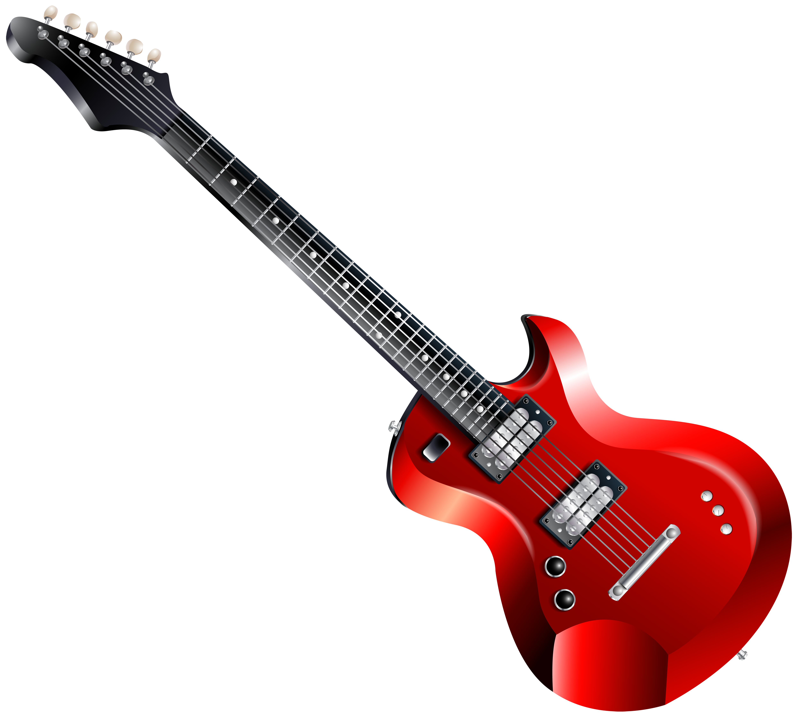
Mrs. Rhodes’s February 24 – March 28
ROCKING NEWSLETTER
WHAT WE’RE LEARNING
Reminders
Read 20 minutes each night
Math sheet
Practice math facts
Practice Automaticity Words
Practice vocabulary words
Please check Pride Binder each night.
Bring snack and water bottle to school every day
Weekly Take Home Folders – This will be a blue folder that will be sent home on Wednesdays. Please make sure this folder is returned with the signed papers from the week.
Weekly Skills
Reading (Unit 8 Earth’s Surface)
Essential Question: How do we understand change?
Earth’s Surface-Unit 8 Week 1 Quiz – Feb 28
Generate and ask questions strategies
Create mental images to deepen understanding using photographs and text evidence to develop accurate visualizations of scientific concepts
Recognize cause and effect relationships in a science text
Use context clues to determine meaning of unfamiliar words
Identify and explain how text and graphic features reveal and support an author’s purpose
Earth’s Surface-Unit 8 Week 2 Quiz – Mar 21
Analyze how story elements are conveyed in folktales
Determine the central idea and important details of a text to develop a clear summary and synthesize information to create new and deeper understanding
Use print or digital resources to determine the precise meaning, syllabication, and pronunciation of unfamiliar words.
Determine the theme of a folktale
Compare and contrast folktales
Earth’s Surface-Unit 8 Week 3 TEST – Mar 28
Identify and explain how text and graphic features reveal and support an author’s purpose
Build vocabulary: use context clues to provide meaning to unclear terms
Recognize the cause effect relationships in a science text
Identify examples of imagery and personification in a poem to determine author’s purpose
Important Dates
February 28 – Edmentum Challenge
March 5 – Lion King Dress Rehearsal
March 6 – Lion King Play (9 & 12:30)
March 7 – Lion King Play (9:00)
March 10-14 – Spring Break
March 19 – End of 3rd Nine Weeks
March 24 – Spring Pictures
April 1-4 – ACAP (ELA)
April 8-11 – ACAP (Math)
Math
Topic 12: Understand Fractions as Numbers
Test – Feb 27
Topic 13: Fraction Equivalence and Comparison
Mid-Chapter Checkpoint Quiz – Mar 6
Test – Mar 21
Contact Information:
School Phone: (334) 887-2110
Email: mkrhodes@auburnschools.org
Class Dojo

Slide 2
Word Study
The words listed below follow certain patterns that we are practicing in class during our lessons each week. These may not be the exact words on the assessment. The students should be able to apply patterns to spell words on the test and the dictation sentences. Study the words on the automaticity sheets each week to assist in learning to spell words with these patterns.
**Spelling & Dictation Test – March 28**
Unit 8 Week 1: Hard and Soft c
When c is followed by the vowel a, o, or u, it usually is pronounced /k/.
Examples:
cave, cost, cuddle
When c is followed by the vowel e, i, or y, it usually is pronounced /s/.
Examples:
cell, city, fancy
Unit 8 Week 2: Hard and Soft g
When g is followed by the vowel a, o, or u, it usually is pronounced /g/.
Examples:
game, golden, guppy
When g is followed by the vowel e, i, or y, it usually is pronounced /j/.
Examples:
gentle, giant, gym
Unit 8 Week 3: Diphthongs /ou/ and /oi/
The diphthongs /ou/ sound can be spelled with “ou” or “ow”.
Examples:
round, sprout, town, growl
The diphthongs /ou/ sound can be spelled with “oi” or “oy”.
Examples:
join, noisy, boy, loyal
Vocabulary
These 15 vocabulary words will be on the test at the end of the 3-week unit. Please keep studying the words & definitions for the test.
**Vocabulary Test – March 27**
Unit 8 Week 1
result – the conclusion or the effect
typical – normal, average; to be expected
region – an area of Earth’s surface with common features
climate – the long-term weather pattern of a region
diverse – various, different, unlike
Unit 8 Week 2
handful – a small amount that can be held in one hand
brighten – to make brighter
arched – curved or shaped like an arch
protected – guarded or shielded from attack or damage
shaped – having been given a shape
Unit 8 Week 3
imbalance – not being in balance or equal
abundant – plenty
exceed – to cross or go over a limit or level
converge – to come together or meet
occasional – not happening too often
Science / Social Studies
Geography/Map Skills
Weather

Slide 3
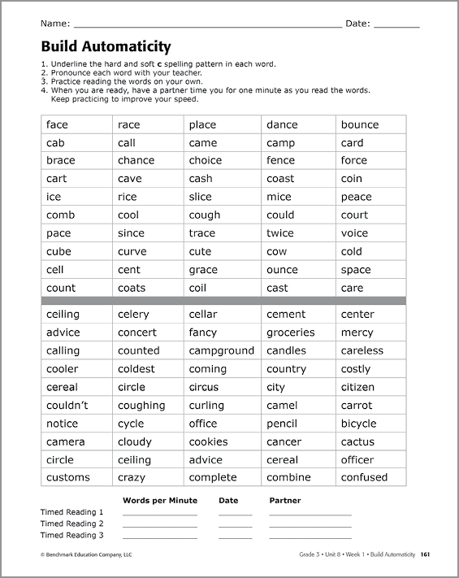
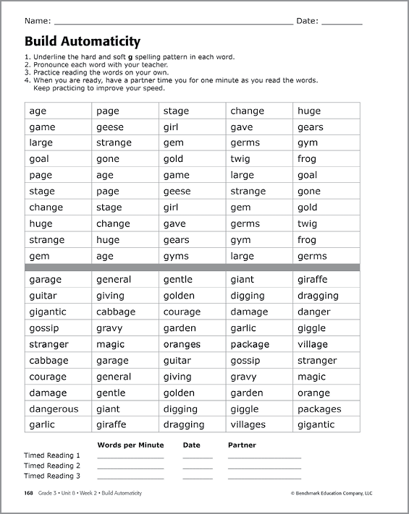
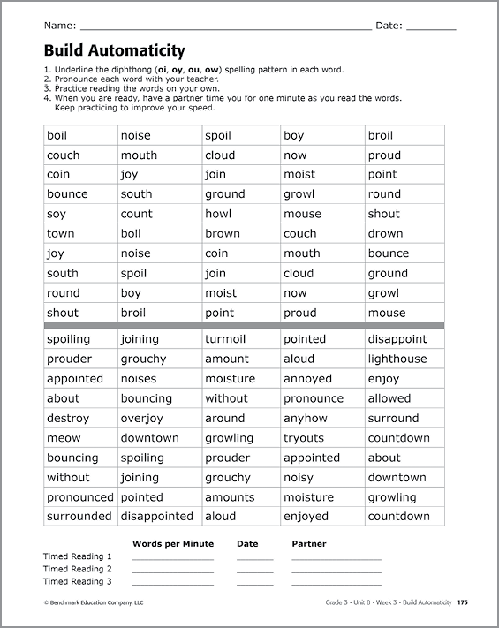
Unit 8 Week 1
Unit 8 Week 2
Unit 8 Week 3

Slide 4
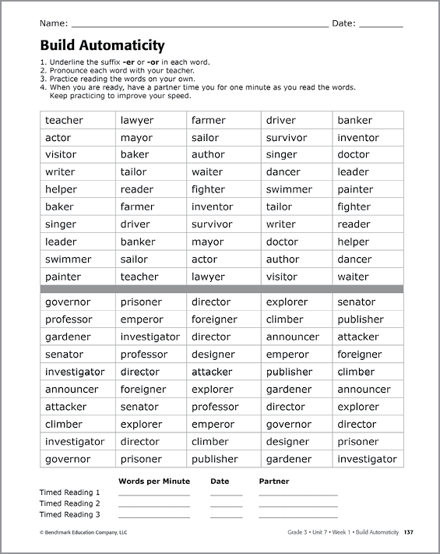
Unit 8 Week 1

Slide 5
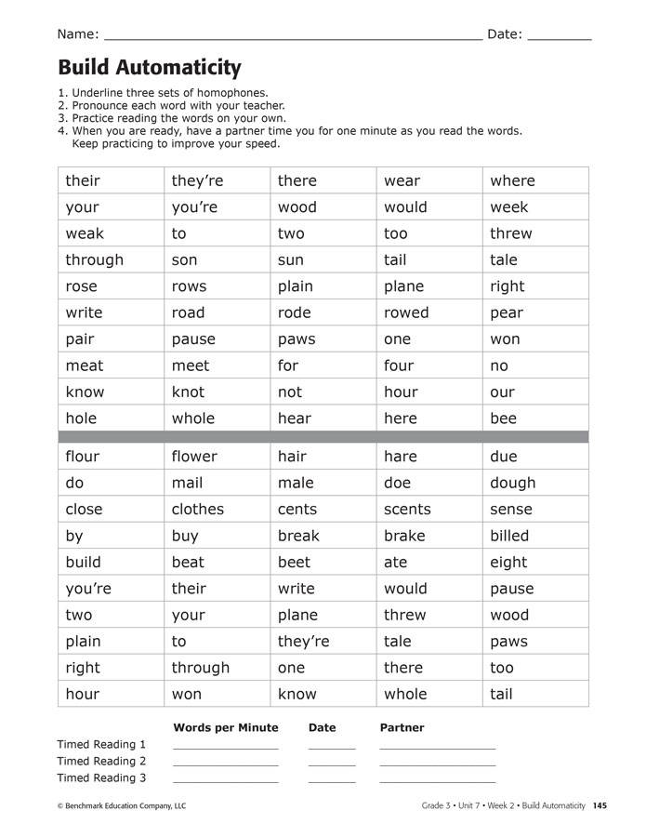
Unit 8 Week 2

Slide 6
Unit 8 Week 3

